Slide 1

Iwiggle: robot follower
Andrey Pak
Donatas Kozlovskis
Enric Cornellà
Fernando Garcia
Igor Péric

Slide 2
Current state
Done
Improvement of arrow detection
In progress
Installation IR LED
To do
Preparation final demo
IR Camera and diodes
Neural Network implementation
Acoustic and visual feedback
Switch to HSV
Projection compensation
Report
Presentation
Launch button
Neural Network integration
Final test

Slide 3

Sound and visual Feedback
Goal: Enhance audio-visual interaction with the system
Background and foreground sound according to current state
Light SFML Library
External Speaker
Current status shown in LCD

Slide 4
REMOUNTING THE CAMERA
Picture of remounted camera
Notes:
Increases field of view.. Less perspective distortion.

Slide 5
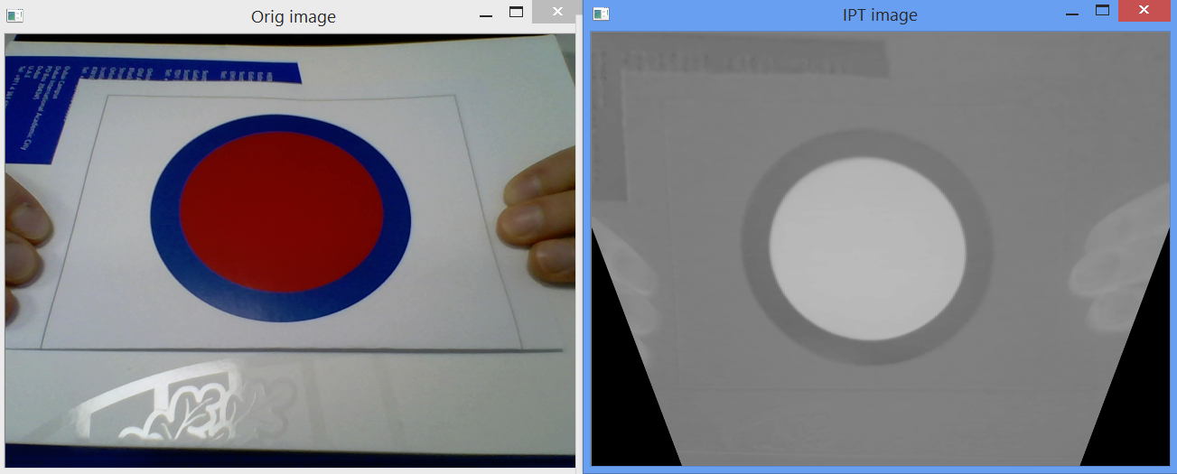
Perspective transform

Slide 6
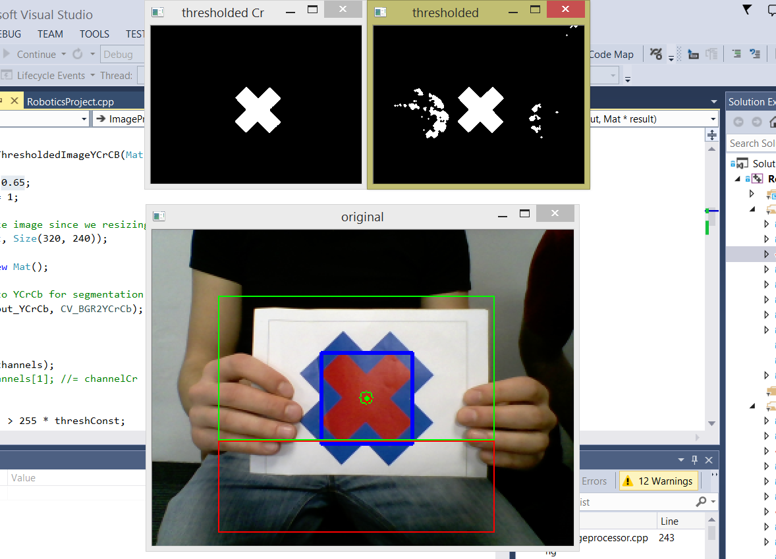
YCrCB segmentation
Notes:
As well, some improvements were made on thresholding and segmentation
YCrCb versus HSV

Slide 7
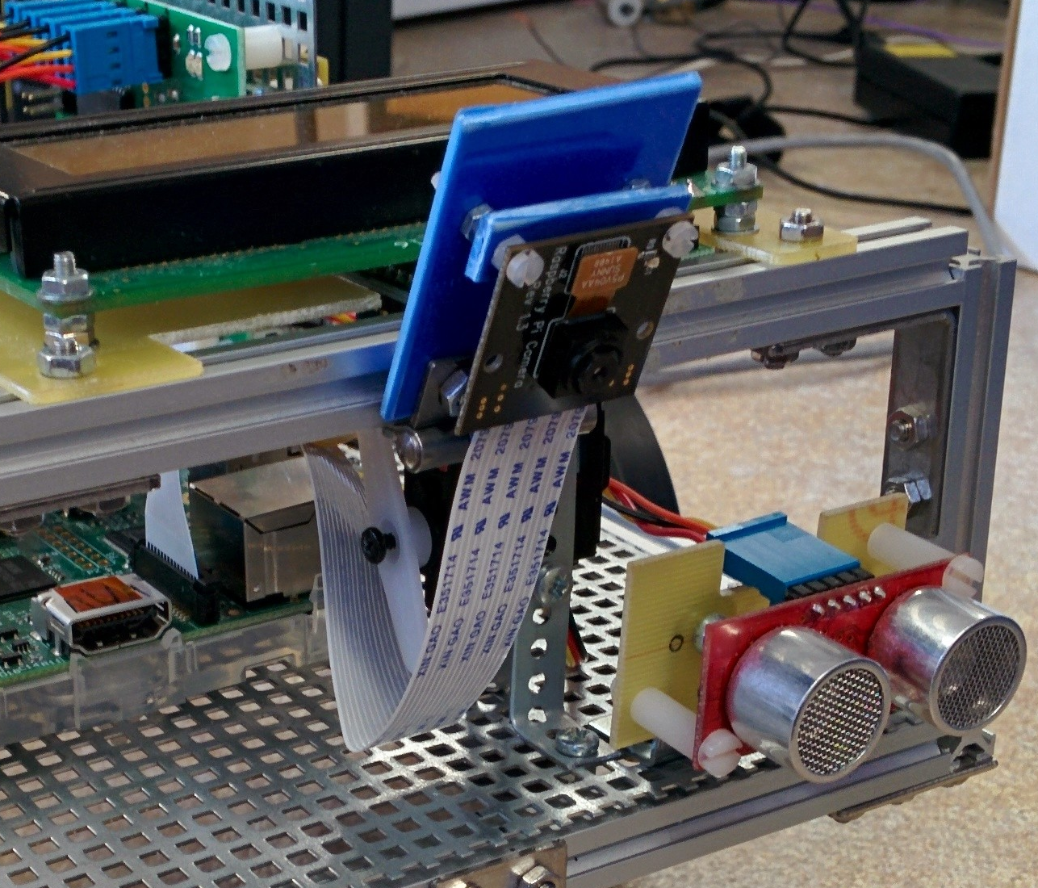
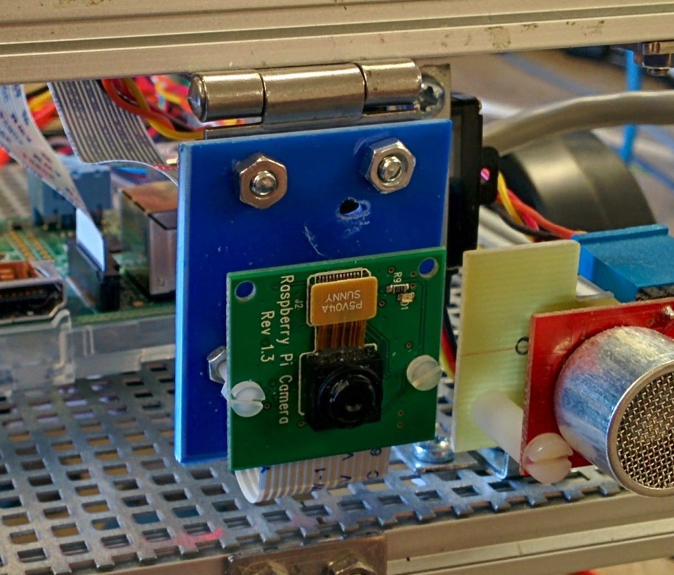
Installation of IR camera
Replacing the old camera by a new one (N-IR)

Slide 8
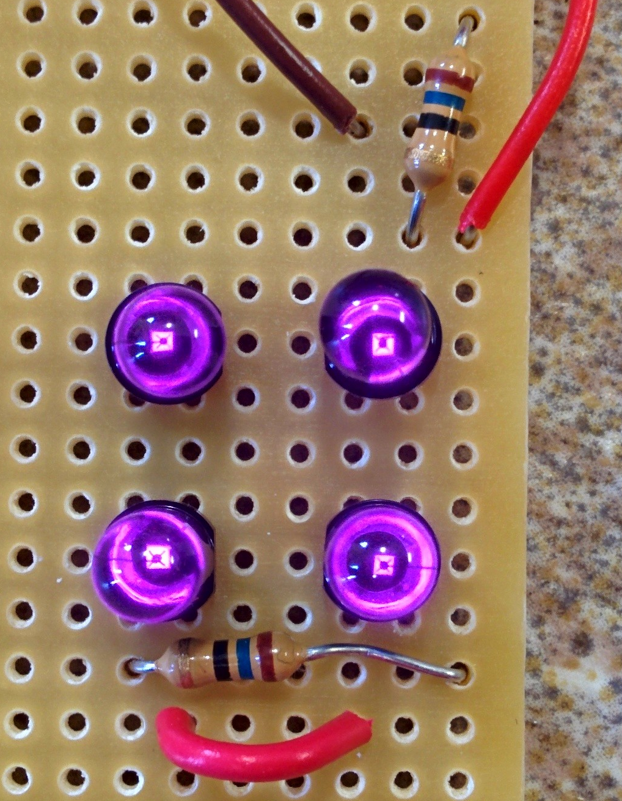
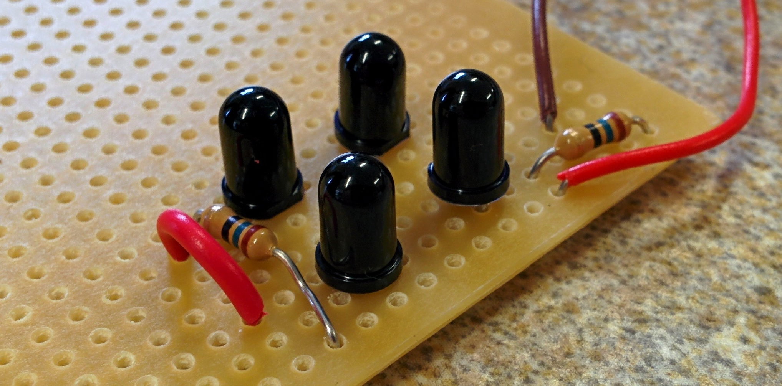
Installation of IR LEDS
IR LED will help with bad lighting conditions

Slide 9
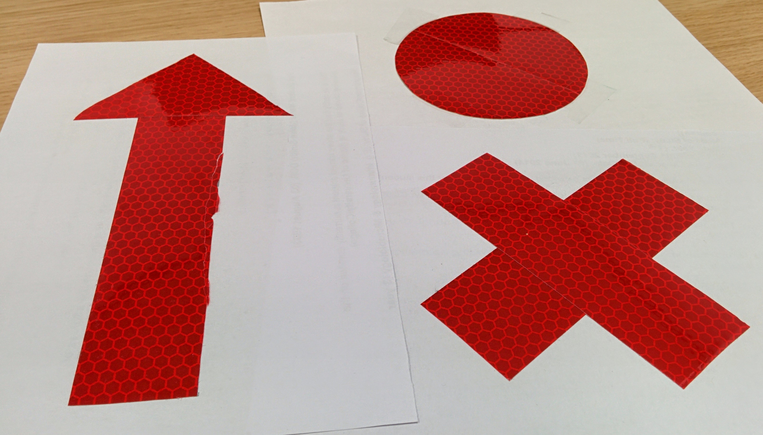
Signs reflective to ir light
New signs designed with IR-reflective material
Performance with good light conditions is the same
Performance with bad light conditions is boosted by IR light

Slide 10
Neural network classifier

